Slide 1

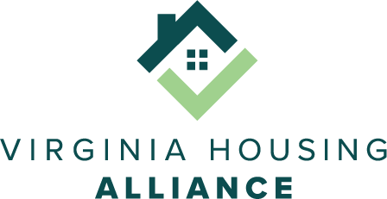
Virginia Housing Commission
HB 1446: Tax Assessments of Affordable Housing
Isabel McLain
Director of Policy and Advocacy
September 4, 2024

Slide 2


The Income Approach
The income approach estimates the property’s value based on its income potential. This approach is necessary to accurately assess the value of properties for which rental income is a significant factor.
Market value = Net Operating Income (Gross Income - Operating Expenses) / Capitalization Rate
The income approach is NOT a tax abatement for affordable housing, but is the generally accepted appraisal practice to assess the accurate market value of rent-restricted housing.

Slide 3


Virginia Code §58.1-3295
A. Notwithstanding any other provision of law, in determining the fair market value of real property operated in whole or in part as affordable rental housing,...., the duly authorized real estate assessor shall consider:
1. The contract rent and the impact of applicable rent restrictions;
2. Restrictions on the transfer of title or other restraints on alienation of the real property; and
3. The actual operating expenses and expenditures and the impact of any such additional expenses or expenditures.
E. Notwithstanding any other provision in this section or other law, the real property governed by this section that is generating income as affordable housing shall be assessed using the income approach based on: the property's current use, income restrictions, provisions of any arm's-length contract including but not limited to restrictions on the transfer of title or other restraints on alienation of the real property, the requirements of subsection B, and all other provisions of this section.

Slide 4
Attorney General’s opinion
“For the foregoing reasons, it is my opinion that assessors must consider fully an affordable housing property’s actual operating expenses and expenditures and the impact of any such additional expenses or expenditures, rather than conduct a cursory review of the property’s statement of income and expenses. It is further my opinion that tax assessments of affordable housing properties must be performed in accordance with generally accepted appraisal practices, procedures, rules, and standards prescribed by nationally recognized professional appraisal organizations...”
October 26, 2023

Slide 5

The Problem:
While there are many assessors correctly following this section of code, violations occur frequently and throughout the state. We know that this has happened in at least 32 different localities, according to reports from affordable housing providers across the Commonwealth.
  “This can make the difference in a property cash flowing for the year or being in the red.”
  “We had to appeal our property taxes on most properties in all jurisdictions every year. It is a tremendous waste of time and money and still often results in valuations (and therefore taxes paid) that are higher than they should be.”
  “The true cost of this higher tax burden is felt by the residents - this translates to less services and less frequent maintenance or repairs.”
  “We estimate that inaccurate assessments on average cost us about $16,000 more in taxes - or about $200 more taxes per unit.”
“Affordable housing projects should pay their fair share of property taxes, but with restricted rents, the "market value" is less than market-rate properties.”

Slide 6

Our Solutions:
  Amendments to code §58.1-3295 to:
    Require that assessors only use the income approach when valuing affordable housing.
      The income approach is not an option “to consider” but a requirement.
      All people conducting assessments, licensed or not, must follow these standards.
    Describe what is required to accurately use the income approach according to generally accepted appraisal practices.
      Prohibit the use of mass appraisal techniques when income and expense statements are provided.
    Improve transparency by requiring prompt access to materials used in arriving at assessments.
    Improve accountability by requiring localities to cover reasonable attorney fees and costs of an appeal if the owner prevails.
    Accurately define “affordable housing” to encompass all intended properties.
  Effective training of assessors about affordable housing and these requirements.

Slide 7
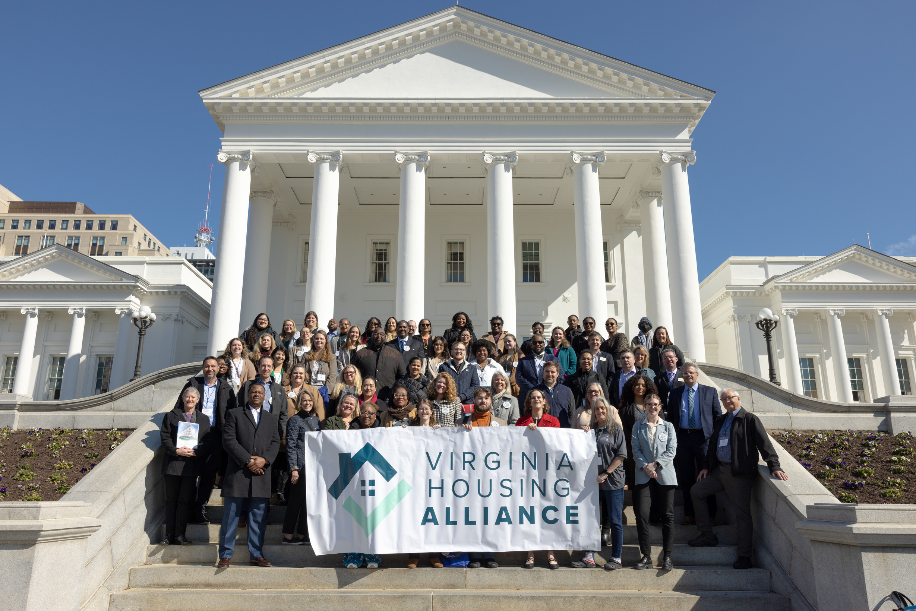

Thank you!
Isabel McLain
imclain@vahousingalliance.org

Slide 8
USPAP Standard 1-4(c)
(c) When an income approach is necessary for credible assignment results, an appraiser must:
(i) analyze such comparable rental data as are available and/or the potential earnings capacity of the property to estimate the gross income potential of the property;
(ii) analyze such comparable operating expense data as are available to estimate the operating expenses of the property;
(iii) analyze such comparable data as are available to estimate rates of capitalization and/or rates of discount;
(iv) base projections of future rent and/or income potential and expenses on reasonably clear and appropriate evidence; and
(v) weigh historical information and trends, current supply and demand factors affecting such trends, and anticipated events such as competition from developments under construction, when developing income and expense statements and cash flow projections.

